Slide 1
Grassroots Innovations in Healthcare
February 11, 2015

Slide 2
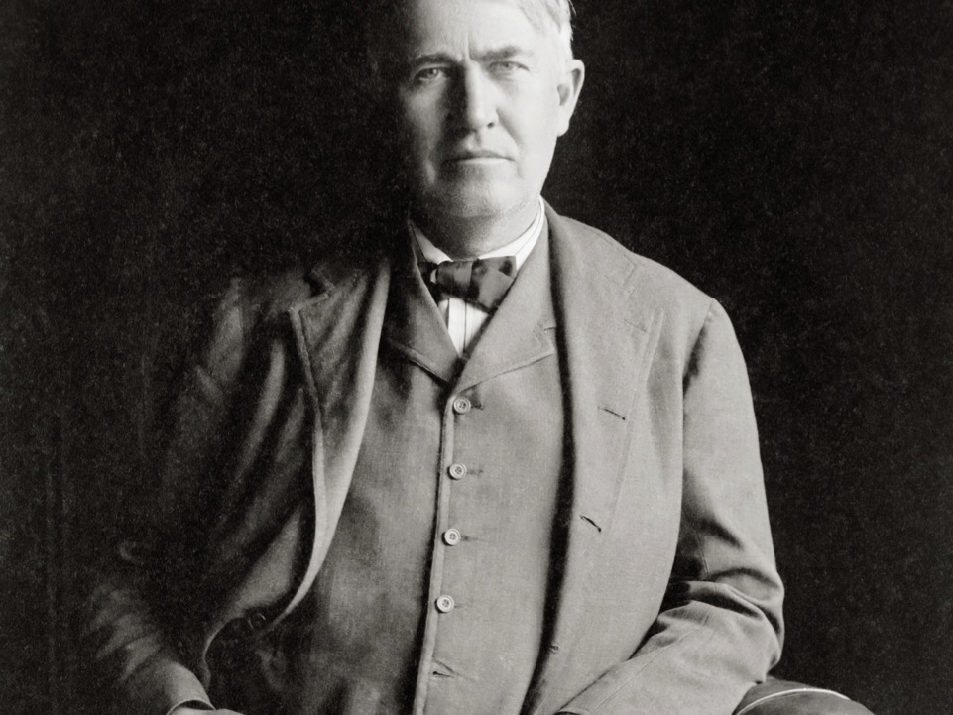

“I find out what the world needs,
then I proceed to invent it.”
- Thomas Edison

Slide 3
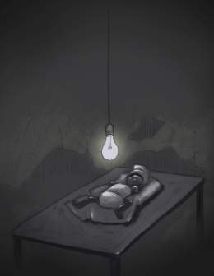
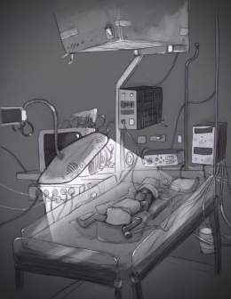
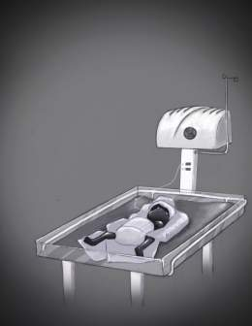
Product Innovation - Infant Care
Globally: 3M infant die within the 1st month
Reality
Compromise
Solution
Infants treated with light bulbs
Lack of positive outcomes
No focus on safety
Low levels of awareness
Make-do with existing equipment
Lack of total solution
Not easy to learn, use, maintain
No sustainability
Bottoms-up holistic design
Co-Created with Users
Innovation along new axes
Self-sustaining “whole offer” solution
Required a fundamental shift in the innovation paradigm
Low Cost | High Tech | Co-Created | Holistic Solution
Requires a fundamental shift in the innovation paradigm
Low Cost … High Cost … High Value … Co-Created … Holistic Solution
Requires a fundamental shift in the innovation paradigm
Low Cost … High Cost … High Value … Co-Created … Holistic Solution

Slide 4
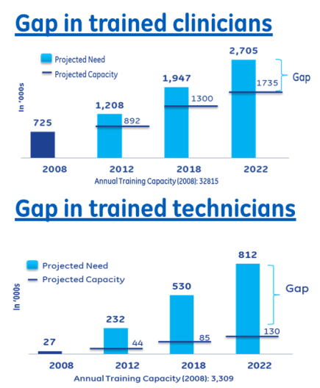
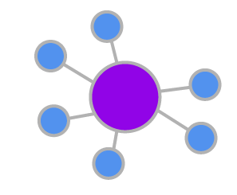

People Innovation - Skill Development
Why- the vision of education
How- implementation strategy
Staggering skill gap in HC at all levels; doctors, technicians, AHPs
Radiology imaging one of the most critical areas per NatHealth
Current courses not adequate; no focus on hands on & standardization
Establish 20 hubs and 60 spoke institutes, across 20 states of the country
Hubs to be center of excellence in region & spoke will be center of delivery
14%
Hub & Spoke Model
Partnered with pvt. Organizations like Max & IL&FS who share the vision for HC skill devpt.
Exploring partnership with different govts. to achieve scale and reach in T2/T3 cities
Partnerships
What- our offerings
Achievements so far
1st Healthcare Institute up and running in Mumbai
2nd HCI in Greater Noida to start operations in Q1
1st batch of, HSSC approved X-ray course on track
75% students placed in month 3 of 1 year program
Coming soon– Bhubaneshwar, Coimbatore, Chennai
Skill Creation – Add skilled resource at entry level in HC
Skill Enhancement- Upgrade skills of existing HCPs
Management- Non-technical courses; effective HC delivery

Slide 5
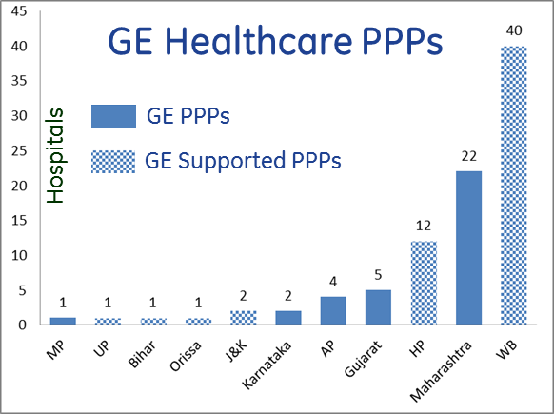



Model Innovation – PPP in Healthcare
Healthcare Issues
Inadequate infrastructure
Delayed execution
Lack of human resources
Obsolete technology / training
Inefficient HC service
Funding issues
Equipment
Manufacturer
Govt Reimburses ← Pay Per Use
CT/ MRI / ULS
Equipment
Government
Hospitals
Consortium
Radiology Services
Clinical Service Provider
Resources/
Expertise
Space
Service
Provider
Partner
Diagnostic / Clinical
Service
Patients

